Slide 1
Legal, Social, Ethical and Professional Issues LSEPI
Professional Experience & Project Development

Slide 2
Data Protection Legislation
Data Protection Act 1984
Data Protection (DPA)Act 1998
General Data Protection Regulation 2018

Slide 3

TurningPoint
There are several ways as a student you can participate in voting system questions
Via a web address https://responseware.eu
By downloading the “TurningPoint” app from the Apple Store (iPhone/iPad) or Play Store (Android)
Session ID - PEPD2019

Slide 4
Do you know what
'personal data' is?

Slide 5
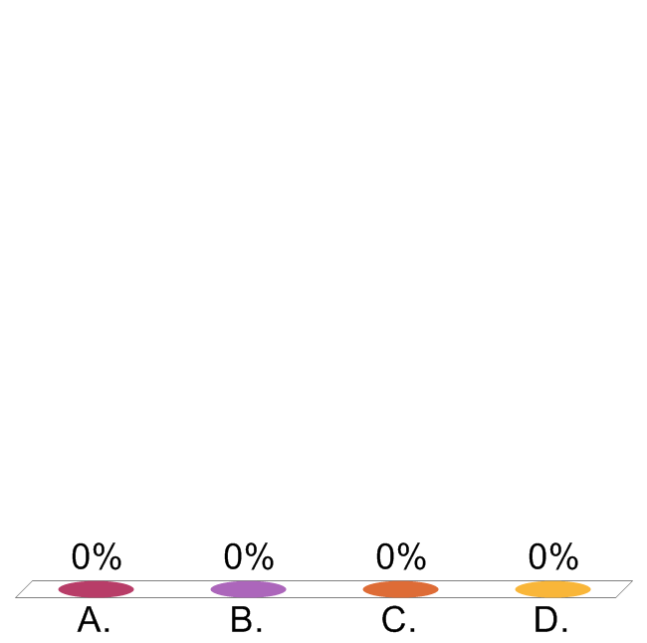
Which of the following statements is true? Personal data may be contained in:
Data held on a computer or computer system only
All electronic records but not emails
All written data but not images/photos
All recorded media

Slide 6
Characteristics of Personal Data
How do you decide if data is personal?
Can you identify a living individual from the data?
Name
Unique identifier
Description
Set of characteristics
In combination with other data you have access to
Does the data tell you something about that individual?
Fact
Opinion
Intention

Slide 7
Personal Data Definition:
GDPR Additions
IP addresses
Biometric data
Genetic data

Slide 8

an event or series of events leading to the unintentional or unauthorised disclosure of information which compromises the security, confidentiality or integrity of data
What is a Data Security Breach?
Notes:
This is the definition that we work to in terms of data security and personal data
Hacking
Email sent to wrong recipient
Loss of paper records
Unauthorised access of data – someone has put something in wrong folder or access rights incorrectly set up

Slide 9
Damage and distress to data subjects
Complaints
from data subjects
Civil action:
Compensation and legal fees
Investigation and enforcement action by Information Commissioner
Loss of trust amongst stakeholders
Possible consequences and actions
Criminal offences
Reputational damage and negative press coverage
Staff disciplinary issue
Monetary penalties or fines

Slide 10
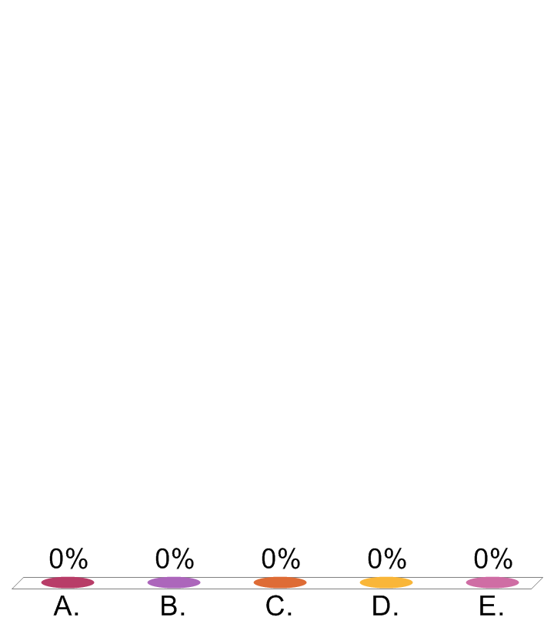
What is the maximum fine under GDPR?
1 million euros or 2% annual turnover
10 million euros or 2%
20 million euros or 4%
25 million euros or 4%
50 million euros or 4%

Slide 11
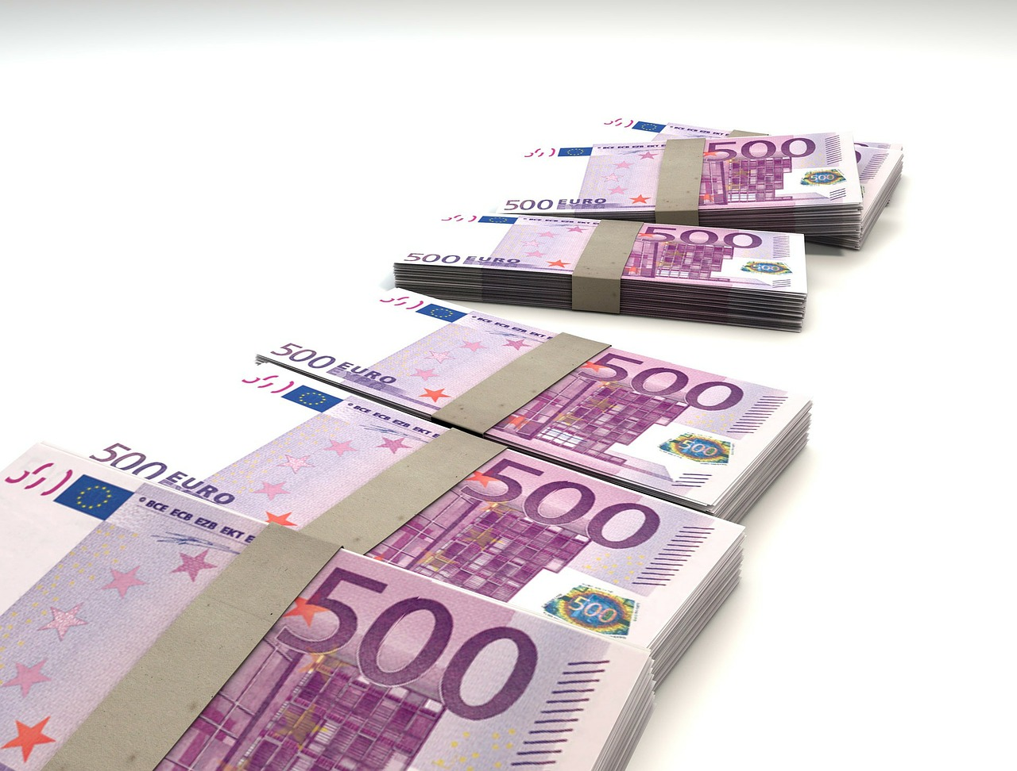
GDPR maximum fine rises to
€20 million or 4% of total worldwide
annual turnover
20 million reasons
to comply...
Notes:
Depending on the type of breach fines will rise to
up to 10,000,000 EUR of 2% of total worldwide annual turnover for the preceding financial year (whichever is higher)
or
up to 20,000,000 EUR or 4% of turnover
The latter includes breaches of the principles, data subjects’ rights, international transfers.

Slide 12
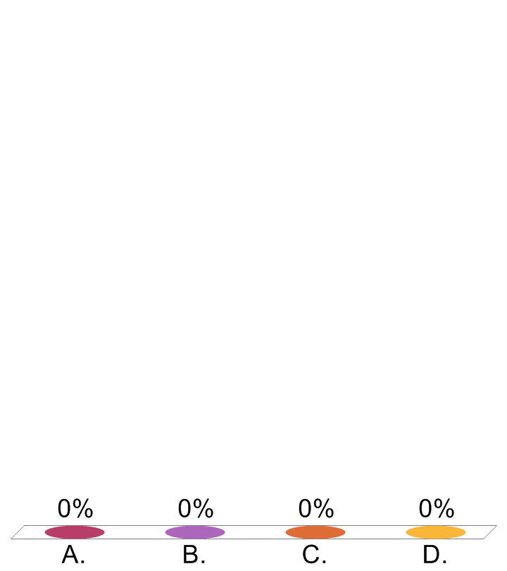
Which security incident resulted in the highest fine?
Talk Talk hacked with loss of 157,000 customer records including bank details for over 15,000 customers
3000 patient records found on second hand computer bought on ebay
HIV Clinic emails newsletter to client and in doing so discloses patient email addresses to other patients
Facebook and Cambridge Analytica unauthorised use of personal data
Sony website hacked compromising the details of millions of customers passwords and payment card details.

Slide 13
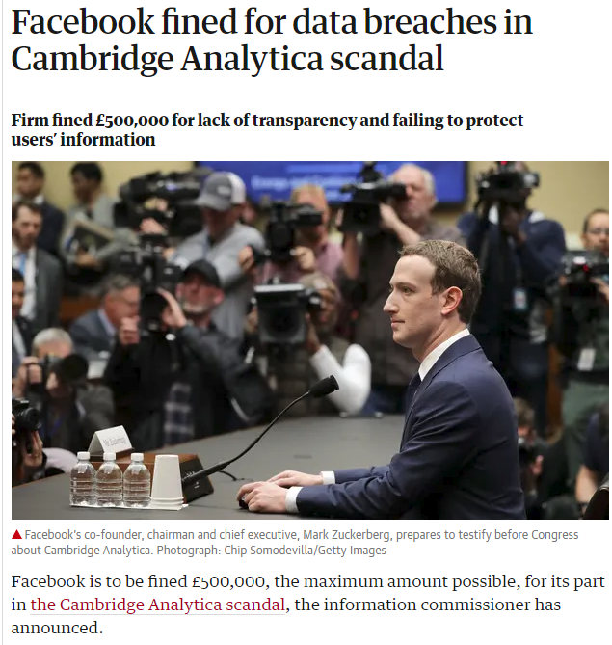
The fine is for two breaches of the Data Protection Act. The Information Commissioner’s Office (ICO) concluded that Facebook failed to safeguard its users’ information and that it failed to be transparent about how that data was harvested by others.
“Facebook has failed to provide the kind of protections they are required to under the Data Protection Act,” said Elizabeth Denham, the information commissioner. “Fines and prosecutions punish the bad actors, but my real goal is to effect change and restore trust and confidence in our democratic system.”
In the first quarter of 2018, Facebook took £500,000 in revenue every five and a half minutes. Because of the timing of the breaches, the ICO said it was unable to levy the penalties introduced by the European General Data Protection (GDPR), which caps fines at the higher level of €20m (£17m) or 4% of global turnover – in Facebook’s case, $1.9bn (£1.4bn). The £500,000 cap was set by the Data Protection Act 1998.
https://www.theguardian.com/technology/2018/jul/11/facebook-fined-for-data-breaches-in-cambridge-analytica-scandal

Slide 14
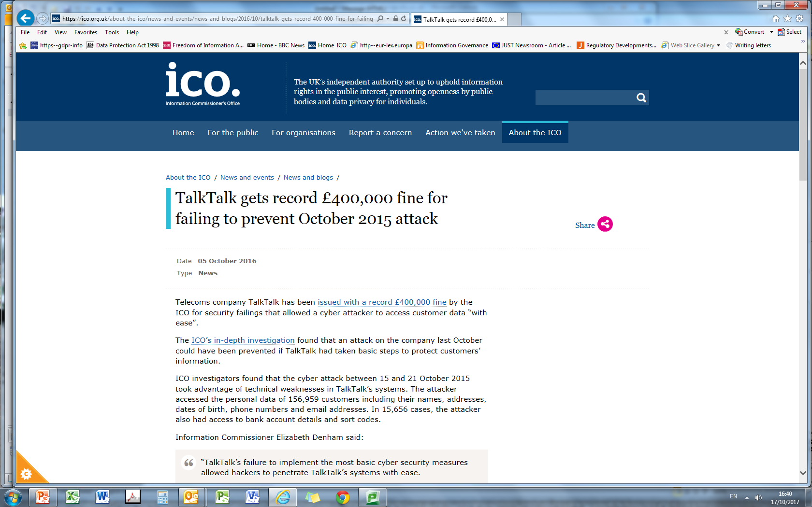
The data was taken from an underlying customer database that was part of TalkTalk’s acquisition of Tiscali’s UK operations in 2009. The data was accessed through an attack on three vulnerable webpages within the inherited infrastructure. TalkTalk failed to properly scan this infrastructure for possible threats and so was unaware the vulnerable pages existed or that they enabled access to a database that held customer information.
TalkTalk was not aware that the installed version of the database software was outdated and no longer supported by the provider. The company said it did not know at the time that the software was affected by a bug – for which a fix was available. The bug allowed the attacker to bypass access restrictions. Had it been fixed, this would not have been possible.
The attacker used a common technique known as SQL injection to access the data. SQL injection is well understood, defences exist and TalkTalk ought to have known it posed a risk to its data, the ICO investigation found.
Information Commissioner said:
“TalkTalk’s failure to implement the most basic cyber security measures allowed hackers to penetrate TalkTalk’s systems with ease.
“Yes hacking is wrong, but that is not an excuse for companies to abdicate their security obligations. TalkTalk should and could have done more to safeguard its customer information. It did not and we have taken action.”
Source - https://ico.org.uk/
Notes:
On top of that the company also had two early warnings that it was unaware of. The first was a successful SQL injection attack on 17 July 2015 that exploited the same vulnerability in the webpages. A second attack was launched between 2 and 3 September 2015.
Almost 157,000 TalkTalk customers had their personal details hacked in last month’s cyber-attack on the telecoms company.
Talk Talk said the total number of customers affected by the attack two weeks ago was 156,959, including 15,656 whose bank account numbers and sort codes were hacked.
The total is 4% of TalkTalk’s 4 million customers and is a small fraction of the number feared when news of the attack broke. The number of customers whose bank details were stolen is lower than an estimate of less than 21,000 released a week ago.

Slide 15
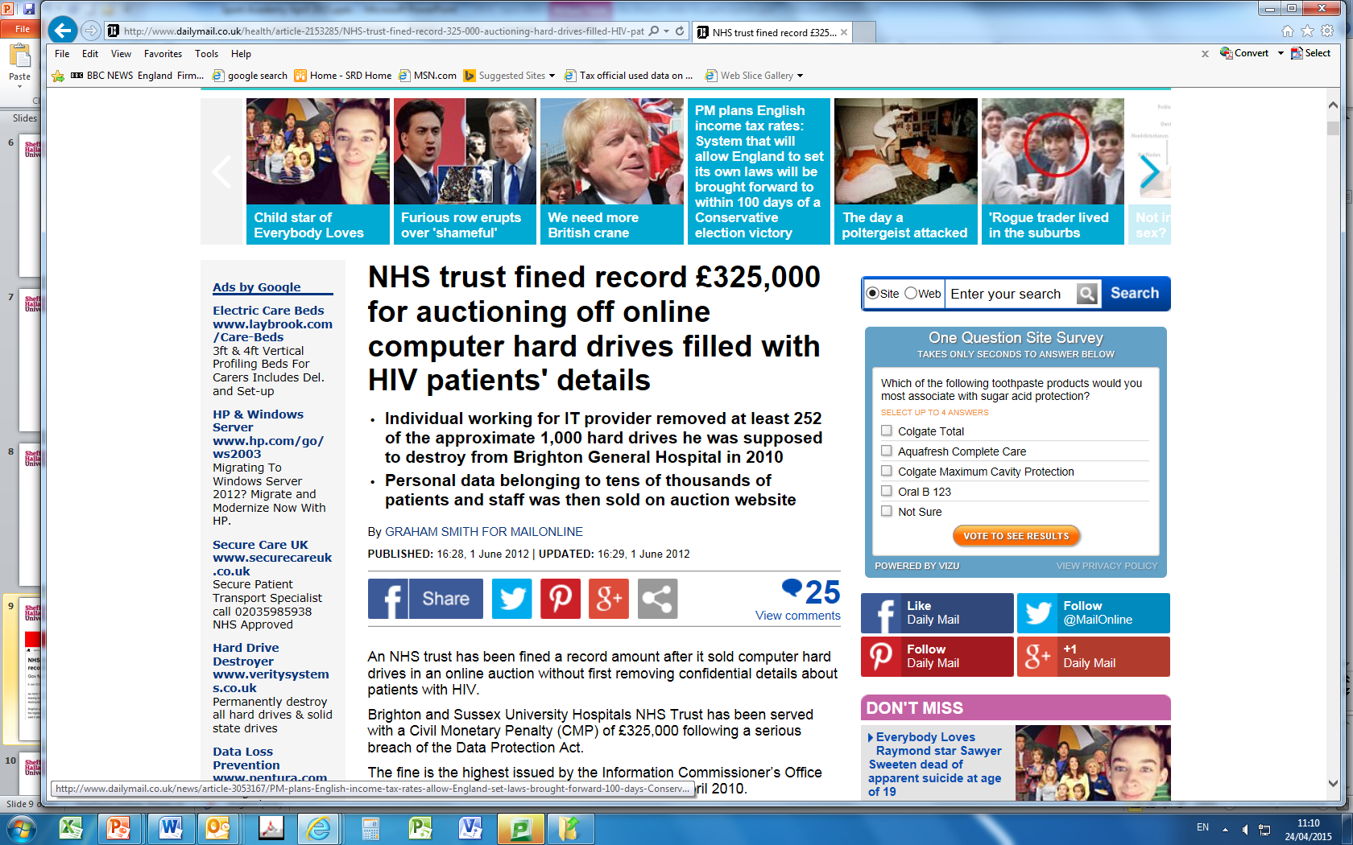
"The data breach occurred when an individual working for the trust's IT service provider, Sussex Health Informatics Service (HIS), was told to destroy approximately 1,000 hard drives at Brighton General Hospital.
A data recovery company bought four hard drives from a seller on eBay, who had purchased them from the individual.”
Source: http://www.bbc.co.uk/news/uk-england-sussex-18293565
Notes:
Destroy hard drives
Highly sensitive data belonging to tens of thousands of people inc HIV and other v sensitive medical areas were discovered on the hard drives
It also included staff details including National Insurance numbers, home addresses, ward and hospital IDs, and information referring to criminal convictions and suspected offences.
"We dispute the Information Commissioner's findings, especially that we were reckless, and a requirement for any fine," he said.
"We arranged for an experienced NHS IT service provider to safely dispose of our redundant hard drives and acted swiftly to recover, without exception, those that their sub-contractor placed on eBay.
Great privacy issue if medical details are shared

Slide 16
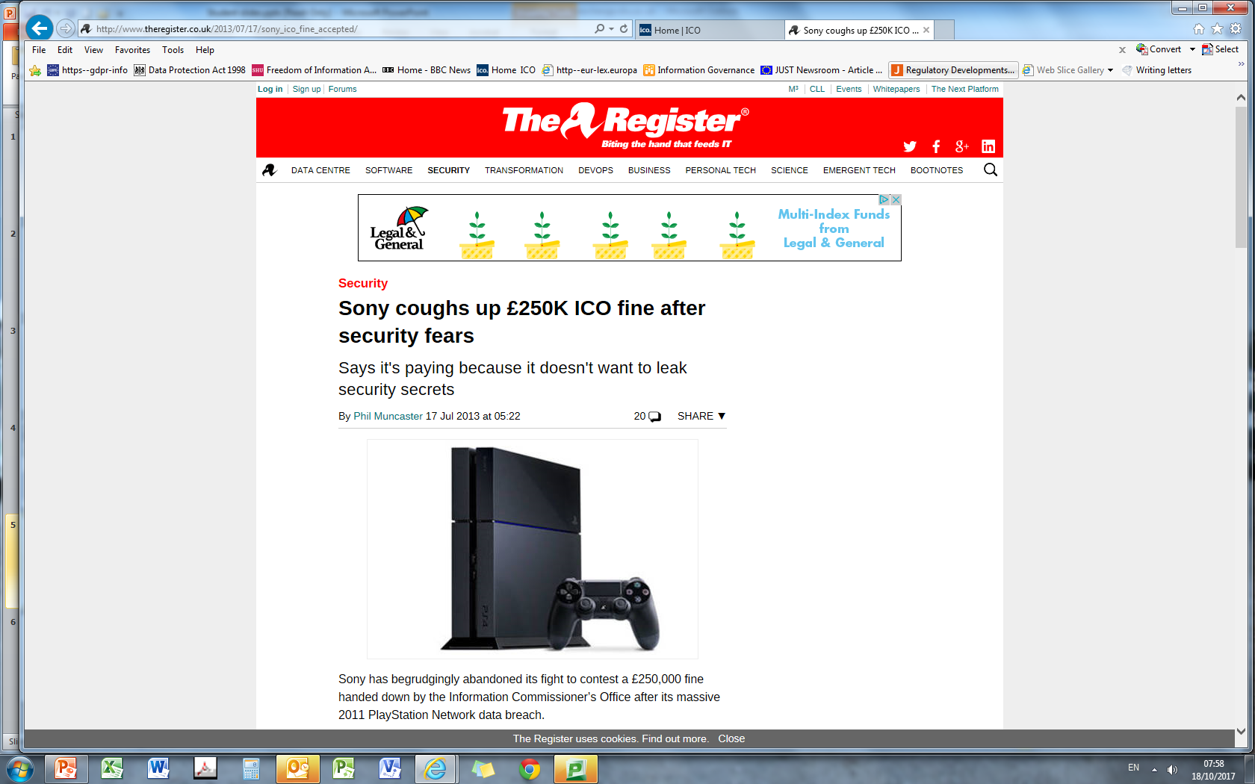
Back in January, the ICO concluded after an investigation that the breach of around 70 million gamers could have been prevented if Sony had taken best practice security measures such as hashing and salting log-ins and keeping system patches up to date.
Deputy commissioner David Smith said in a statement released at the time:
There’s no disguising that this is a business that should have known better. It is a company that trades on its technical expertise, and there’s no doubt in my mind that they had access to both the technical knowledge and the resources to keep this information safe.
The Japanese electronics giant was slapped with the fine back in January for breaching the Data Protection Act after the personal info of millions of Brits – including names, addresses and account passwords – were stolen by hackers who infiltrated its PlayStation Network systems.
Source: http://www.theregister.co.uk/2013/07/17/sony_ico_fine_accepted/
Notes:
Sony has now decided not to fight the fine, despite still strongly opposing it, because of fears the Information Rights Tribunal would have forced it to divulge sensitive details about its network security set-up.
This decision reflects our commitment to protect the confidentiality of our network security from disclosures in the course of the proceeding,” a Sony spokesman told the BBC.
"We continue to disagree with the decision on the merits.”
Clearly impact on individuals if payment details were breached

Slide 17
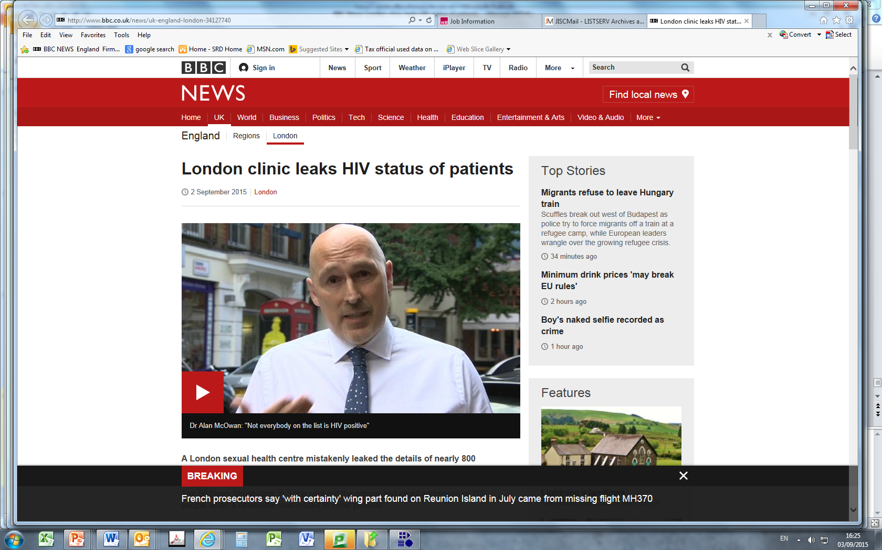
A London sexual health centre mistakenly leaked the details of nearly 800 patients who have attended HIV clinics, bosses have admitted.
The 56 Dean Street clinic in Soho sent out the names and email addresses of 780 people when a newsletter was issued to clinic patients.
Patients were supposed to be blind-copied into the email but instead details were sent as a group email.
"I felt sick when I realised what had happened.....
I couldn't breathe."
"I'm concerned who will get this information. If it ends up in the hands of the wrong people, such as hate groups, it could be dynamite."
Health Secretary Jeremy Hunt said the breach was "completely unacceptable".
http://www.bbc.co.uk/news/uk-england-london-34127740
Notes:
ICO fined £180k

Slide 18
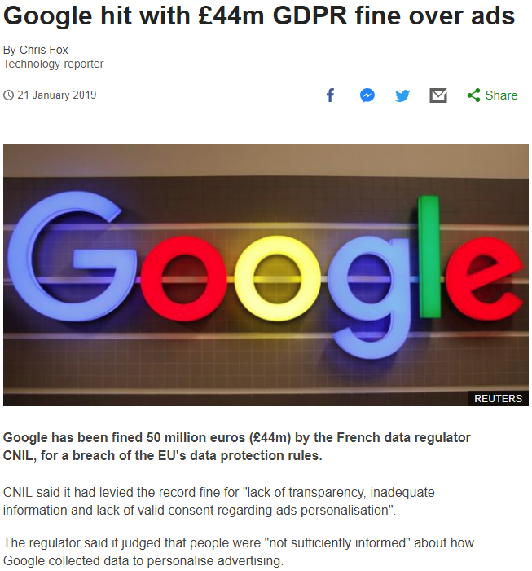
https://www.bbc.co.uk/news/technology-46944696

Slide 19
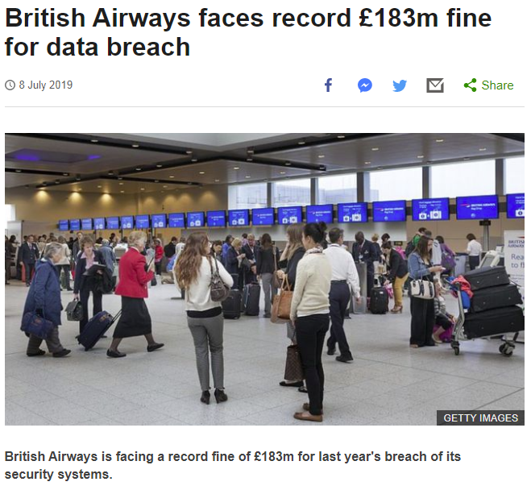
https://www.bbc.co.uk/news/business-48905907
Notes:
Fine was only 1.5% of global turnover, had it been the full 4% the fine would have been in the region of £500m

Slide 20
A Question of Data Security
What happens next?
Notes:
EMMA

Slide 21

Right to be informed
Subject Access Requests
Rectification
Restriction of processing
Right to object to processing
Automated decision making including profiling
New Additions:
Data portability
Erasure
Data Subject Rights
Notes:
Data subjects have enhanced rights
New rights around having data deleted - especially aimed at social media and individuals' online presence but relevant for other organisations – not required to delete in all circs - for instance if we have a legal obligation to hold data, you can’t demand that we delete it, but in many cases we organisations will need to delete.
Data Portability - where records can be moved easily between one service provider and another are likely to be more relevant to utilities
New emphasis on automated decision making and profiling of individuals as the basis for decision making – being able to explain how this automation works
Right to be informed – Privacy Notices – you know all those little links to Privacy Notices that you sign up to something – most people just click to say they have read or accepted without reading – I write those – these are DP requirements –I always read them – tell you how the organisation will use your data, who it will share it with etc. These become much more detailed under GDPR – the notice becomes the essay! As future app developers – you will need to ensure that the Privacy Notice is in place if you are collecting personal data

Slide 22
Some other legal issues to consider
Contractual obligations – employment contract, NDAs, supplier and processor contracts
Copyright and Intellectual Property
Privacy and Electronic Communications Regulations (PECR) in relation to electronic marketing communications and cookies
Human Rights Act
Filtering, monitoring, investigating complaints – legislation around pornography, offensive materials, Prevent
Notes:
Private use of PCS at work – but not for running other business and not if it conflicts with your work duties
Areas for further research

Slide 23
GDPR Requirements - Data Breach Notification
Notification of security breach to ICO within 72 hours of becoming aware of it, unless there is minimal risk to individuals.
The report should include:
the nature and scale of the breach
the contact details for the organisation's DPO
potential consequences and the actions taken to minimise these.
Notification of breach to data subjects asap where high risk to individuals.
Not required if:
organisational measures are in place such as pseudonmysation or encryption
measures have been taken so the posed risk is unlikely to occur
it would take disproportionate effort; in which case a public statement should be made
Notes:
Already consider notifying individuals and ICO but under GDPR these become mandatory
Onerous responsibility on organisations – what happens when you discover one at 4p.m. on a Friday – joke in our office that Friday afternoon is always the time that a data breach or some other crisis or legal issue is reported.
Think about supply chain
Designed to help data subjects to check their data, change their passwords, check their bank accounts etc. in good time

Slide 24
1
Discovery
Reporting
5
Evaluation
Response
6
Implementation
Audit
2
3
4
Assemble Data Breach Team
Containment
Notification
Recovery
Data Security Breach Management Procedure
Notes:
Discovery may be report from staff, complaint from a data subject, a finding from a routine audit or check
Not always in exact order – may be some initials containment and recovery before data breach team meets – pulling plug on something or someone racing across town to retrieve something

Slide 25

GDPR Implementation: 25 May 2018
Resources:
Information Commissioner’s Office https://ico.org.uk
EU GDPR Portal http://www.eugdpr.org
IT Governance GDPR infographic: https://www.itgovernance.co.uk/data-protection/eu-gdpr-infographic

Slide 26
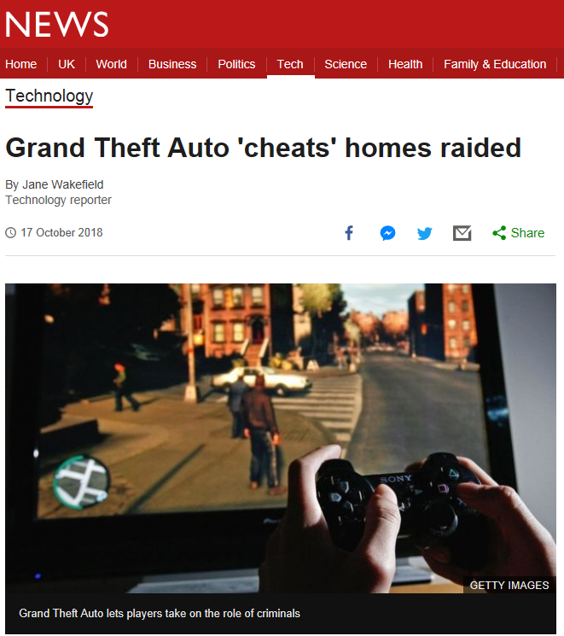
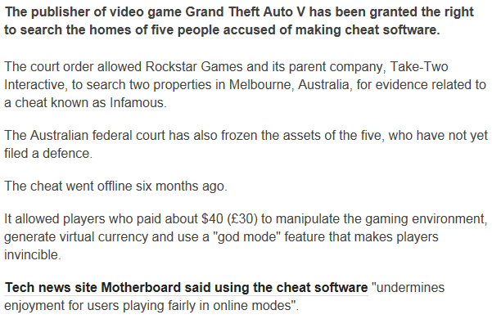
Is Cheating Acceptable?

Slide 27
Member of staff's IT account hacked
Member of staff used work email for personal banking and responded to phishing email.
Visitor saw login details on post it note on their desk
Gave out login details to PA on bus unaware that a fellow passenger recognised login as SHU
Someone put key logger on personal device (BYOD)

Slide 28
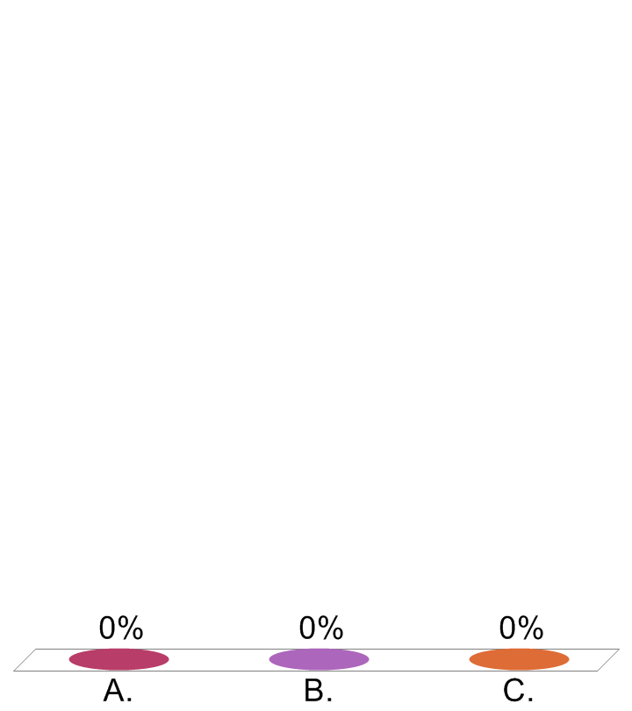
Contractor is issued a day pass to a secure building. His actions result in the theft of a laptop. What did he do?
Lost the pass, didn't report the loss, someone else used it to access the building
Let someone tailgate him into the building
'Helpfully' propped door open for delivery men which allowed thief to access building

Slide 29
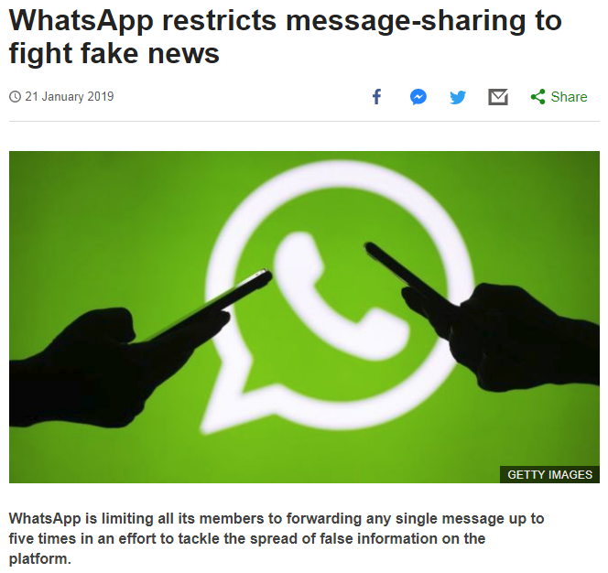
https://www.bbc.co.uk/news/technology-46945642

Slide 30
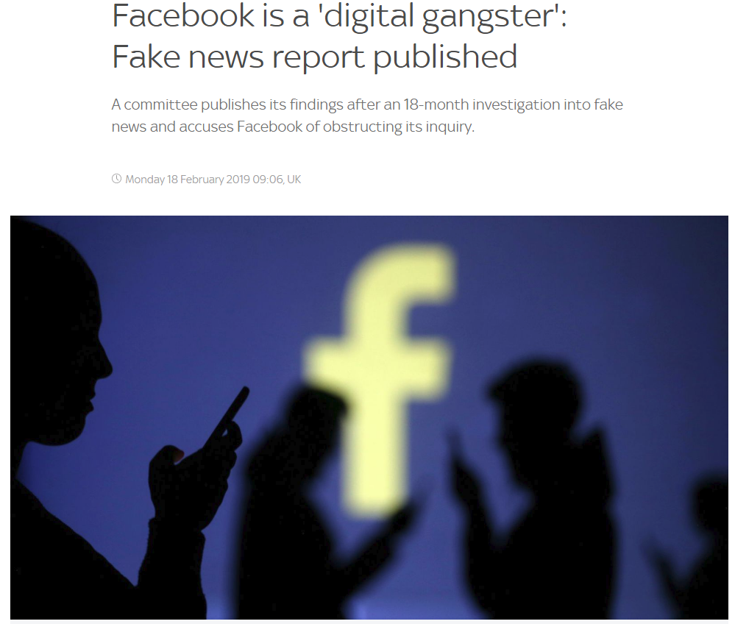
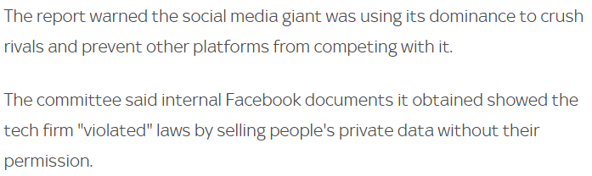

https://news.sky.com/story/mps-call-for-ethics-code-to-tackle-fake-news-and-harmful-content-on-facebook-and-twitter-11640821

Slide 31
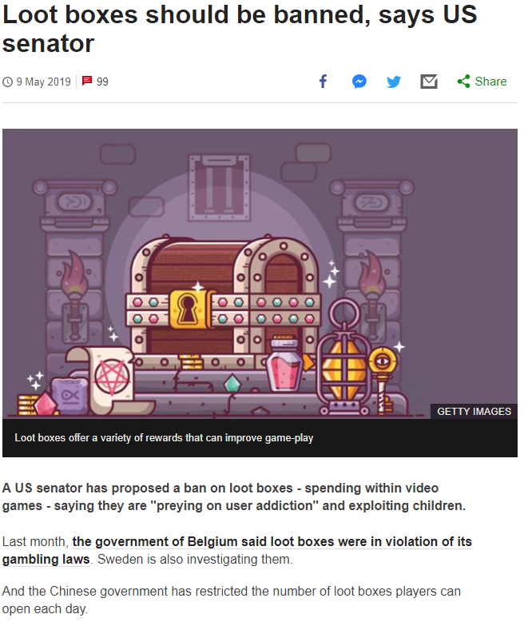
https://www.bbc.co.uk/news/technology-48214293

Slide 32
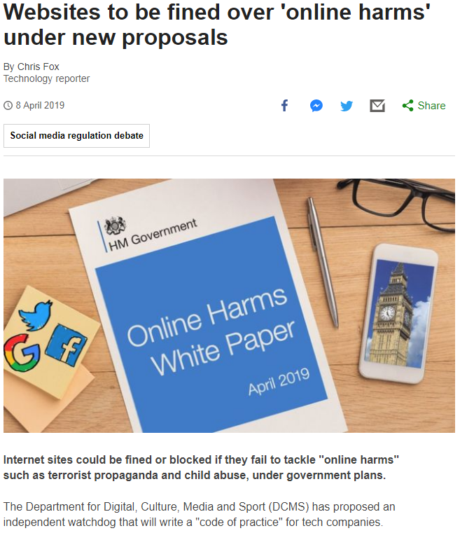
https://www.bbc.co.uk/news/technology-47826946

Slide 33

Richard O’Dwyer
Born in UK in 1988
Created website TVShack in 2007
indexed links to movies, music, TV
Domain seized by US Customs in 2011 violating US copyright law
Faced maximum of 10 years imprisonment
criminal copyright infringement and conspiracy to commit criminal copyright infringement
Sheffield Hallam University student
Request to extradite to US approved by Home Secretary in May 2012
November 2012 agreed to “deferred prosecution” plead guilty to lesser offence
£10K fine and promise to not do it again!

Slide 34

Aaron Schwartz
Born in USA in 1986
Co-developer of RSS & Markdown (age 14)
Coder for Creative Commons (age 15)
Co-founder of Reddit/Infogami (age 19)
Founder of Demand Progress (age 24)
Arrested in 2011 for “simultaneously” downloading academic articles from JSTOR on MIT campus
2 counts of wire fraud and 11 violations of Computer Fraud and Abuse Act
Maximum penalty $1million fine and 50 yrs imprisonment
Committed suicide on 11 Jan 2013, at age 26
The Internet’s Own Boy (The Story of Aaron Schwartz)
Aaron’s Law
Proposed amendments in 2013 to CFAA to exclude “Terms of Service” from felony offence were stalled in 2014 allegedly to protect Oracle’s financial interests

Slide 35

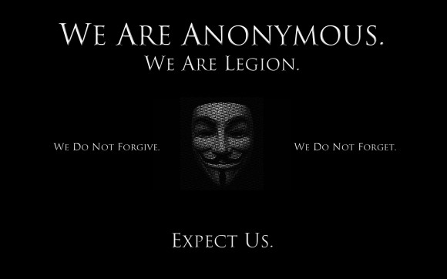
Ryan Ackroyd
Aka “Kayla” and “Lolspoon” Lulzsec hacker
During “50 Days of Lulz” in 2011 hacked Booz Allen, CIA, FBI, SOCA, AT&T, US Navy, Fox.com, Sony, amongst others
Retaliated against PayPal, VISA, MasterCard stopping payments to Wikileaks
Arrested in 2011 sentenced in 2013 to 30 months
Dr David Day, from SHU helped convinct co-offenders “Tflow” and “Topiary”
Studied MSc Computer Security & Forensics here at SHU
"For me, it wasn't about stealing people's information, I just wanted to show people how flawed their so-called secure systems are… I'm like Jiminy Cricket, only when you don't listen I'd hit you really hard with my tiny umbrella so you'd do the right thing,"

